Slide 1


Slide 2







Slide 3

Contract of Guarantee

Slide 4
Importance of Guarantee
In any financing, banks /DFI protect their financial exposure by taking some form of security. When an applicant for an advance can’t offer any tangible security, the banker may rely on personal guarantees
It is an important tool of modern business world

Slide 5
What it Guarantee
Section 126 of the Contract Act, 1872, defines ‘guarantee’ as
“A contract to perform the promise, or discharge the liability, of a third person, in case of his default”.
Guarantee may be either oral or written

Slide 6
Parties to Guarantee:
Guarantor:
Guarantor is a person who gives surety in favor of the principal debtor as a third party, to the creditor.
Principal Debtor:
Principal debtor is the person in whose favor the guarantee is issued by the guarantor.
Creditor:
Creditor is the person to whom guarantee is provided by the guarantor.

Slide 7
Capacity of Guarantee
Authorized to enter into contract
Guarantor at the age of majority
Sound mind

Slide 8



Sec 128 of the contract act 1872 provides:
The liability of the guarantor is co-extensive with that of the principal debtor, unless it is otherwise provided by the contract.
Example:
A guarantees to B the payment of a bill of exchange by C, the acceptor. The bill is dishonored by C. A is liable not only for the amount of the bill but also for any interest and charges which may have become due on it.

Slide 9


Liability of guarantor is secondary.
Liability of guarantor arises immediately, after the creditor give notice of default to guarantor.
Where the creditor holds securities from the principal debtor for his debt, the creditor need not first resort to these securities before giving the notice to the guarantor about the default of principal debtor.
The guarantor will not be liable, where the creditor has obtained guarantee by misrepresentation.

Slide 10
CONT….
5. Law does not treat the principal debtor and surety as one person. It is not necessary that surety will be liable only if the principal debtor is liable. One may be liable while the other may not be
For Example:
If some variation in the contract is done later on the contract by the creditor and principal debtor, without guarantor's consent, the surety is not liable while the principal debtor is liable.
A discharge of the principal debtor by the operation of law e.g.; Insolvency does not discharge the guarantor.
The creditor can not ask the surety to pay under the contract of guarantee unless the creditor has performed his part of contract.

Slide 11





Slide 12


Example:
G guarantees K for the payment of 5 bags of wheat purchased by C. Then C makes payment. Latter on C again purchases 5 bags of wheat. C did not pay for that. K sued G. Held, G’s guarantee is specific guarantee and G is not liable.

Slide 13

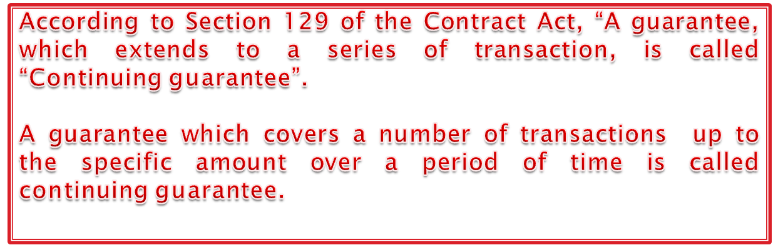
Example:
A guarantees to C for B’s credit purchases with a running balance of account not exceeding Rs.50,000 for 3 months. This is the continuing guarantee.

Slide 14
Importance of continuing guarantee
No need of entering in contract of Guarantee again and again.
Facilitating the similar transactions (credit purchases)
Up to specific amount and specific period

Slide 15

Revocation of continuing guarantee
A continuing guarantee may at any time be revoked by the surety, as to future transactions, by notice to the creditor.
The liability of surety comes to an end regarding the future transactions after the surety has served the notice of revocation. The surety remains liable for transactions entered into prior to the notice. (Sec 130)
Case:
Where the directors of the company guaranteed the payment of the company’s overdrafts and subsequently resigned their office and the bank was informed, it was held that the liability would be confined to the amount due up to the date of resignation.( Hormonal gadwall vs. state bank of India).

Slide 16
Rights of a Guarantor
Guarantor has the right to ask the creditor to inform him of the amount for which he is liable under the terms of guarantee.To maintain customer secrecy bank should not provide the copy of customer statement,until on the request from customer.If due debt exceed the amount of guarantee the banker should merely inform guarantor that he is liable for full amount of the guarantee.
If the principal can’t pay, and is adjudicated a bankrupt, the guarantor is entitled to prove on his state.
The guarantor may himself pay the principal debtor’s debt and enforce his remedies against the principal and succeeds to all the banker's.

Slide 17
Rights of a Guarantor (contd….)
Guarantor may revoke the guarantee after giving sufficient notice.All outstanding cheques presented after the receipt of notice can be paid at banker’s risk.In order to safeguard against these risks.The bankers include an express provision requiring the guarantors to give notice of a specified period before terminating their liability on guarantees.
When the guarantor has discharged his liability under the guarantee.He not only succeeds to the bankers rights and equities, but is also entitled to benefits from all or part of the principal debtor’s securities held by the banker as cover for the guaranteed debts.

Slide 18
Rights of Creditors
If the principal debtor defaults, the creditors can recover the amount due under the guarantee from the guarantor
The creditor is entitled to sue the guarantor even if the advance made to the principal debtor has become time barred.
The law of limitation does not apply to a guarantee and remains operative in the case of principal debtor.
A banker can sue the principal debtor after filing a case against a guarantor,but it should be done within the period of limitation.

Slide 19
Guarantee By Misrepresentation
It is necessary that all the parties to a contract should give their free consent; but when the guarantee is obtained by means of misrepresentation on a material part of the transaction, no such free consent can be said to exist. Thus, any misrepresentation would entitle the guarantor to withdraw.

Slide 20
Demand For Payment
In case of default
Bank may not sue customer
It may serve formal notice to Guarantor

Slide 21
Determination of Guarantee
A contract of guarantee may come to an end in any one or more of the following cases:

Slide 22
Payment by Debtor
Payment by principal debtor
Guarantor is discharged from his liability

Slide 23
Payment by Guarantor
Guarantor’s liability ends
Two folds of this phenomenon
Demand of payment by creditor
Payment by Guarantor without creditor’s demand of payment

Slide 24
Misrepresentation
A contract of guarantee is liable to be avoided if induced by misrepresentation though made innocently

Slide 25
Notice of Guarantor’s Death
Contract of guarantee is discharged when creditor receives the notice of guarantor’s death

Slide 26
Insolvency of Guarantor
Guarantee is terminated
Termination applies to further advances only
Guarantor’s liability to advances already made remains valid
Bank may demand payment from principal debtor

Slide 27
Change of Parties
Death
Insolvency
Retirement
Admittance of new partners
If guarantee do not provide for any such contingency, the guarantee will be revoked

Slide 28
Release of debt by Creditor
Liability of Guarantor is discharged
Through Limitation Act
Discharge of the principal debtor after adjudication in bankruptcy does not affect the guarantor’s liability.

Slide 29


